Slide 1
CSE 391: Programming for the Internet
M. Abdur Rahman

Slide 2
Prerequisite
Join the Piazza and buX course for updated information.
At least One Programming Language idea
Data structures
OOP
Idea Over XML
Database
Software Engineering
Software Analysis and Design

Slide 3
Acknowledgements
Software Engineering for Web Applications (MIT Open Course Ware)
COMP519: Web Programming (University of Liverpool)
  http://www.csc.liv.ac.uk/~martin/teaching/comp519/
Teach Yourself Ajax in 10 Minutes, Phil Ballard, Sams Publishing, 2006
http://www.w3schools.com

Slide 4
HTTP
Hypertext Transfer Protocol (HTTP):
  application-level protocol for distributed, collaborative, hypermedia information systems
  generic, stateless, object-oriented
  can be used for many tasks, such as name servers & distributed object management systems
  underlying language of the Web
HTTP/1.0 allows only connectionless message passing
  each request/response requires a new connection
  to download a page with images requires multiple connections
    can overload the server, require lots of overhead
HTTP/1.1 provides persistent connection by default
  once client & server connect, remains open until told to close it (or timeout)
    reduces number of connections, saves overhead
  client can send multiple requests without waiting for responses
    e.g., can request all images in a page at once

Slide 5
HTTP
1997-2014
Minor improvements and clariﬁcations of HTTP/1.1 are developed
2015 – HTTP/2
Major revision of HTTP with focus on eﬃciency and privacy improvements
HTTP/2 allows a server to push resources to client even before they are requested
HTTP/2 puts more emphasis on encrypted connections

Slide 6
HTTP
Web clients (web browsers) and web servers use
HTTP (Hypertext Transfer Protocol) to communicate with each other

Slide 7
GET request
most URL’s (Uniform Resource Locator) have the form:
protocol://serverName URI
  e.g., http://student.bu.ac.bd/~u07101027/index.html
to retrieve a document via HTTP from the server, issue a GET request using the HTTP protocol
GET URI HTTP/1.1
Host: serverName
Here URI (Uniform Resource Identifier) is file or folder in server.
Web server only knows the contents of the GET request message
  automatically generated by browser when you select a URL
  could also come from a link checker, a search engine robot, …
  can come directly from a telnet connection using port 80

Slide 8
GET example
HTTP/1.1 200 OK
Date: Mon, 08 Oct 2011 10:01:15 GMT
Server: Apache/2.0.58 HP-UX_Apache-based_Web_Server (Unix) mod_perl/1.99_16 Perl/v5.8.7 DAV/2 PHP/5.0.4
Last-Modified: Mon, 01 Oct 2011 14:55:16 GMT
ETag: "ec3f-1122-9fd83d00"
Accept-Ranges: bytes
Content-Length: 4386
Content-Type: text/html
<!DOCTYPE html PUBLIC "-//W3C//DTD XHTML 1.0 Strict//EN“ "http://www.w3.org/TR/xhtml11/DTD/xhtml1-strict.dtd">
<html xmlns="http://www.w3.org/1999/xhtml" xml:lang="en" lang="en">
<head>
. . .
. . .
</head>
<body>
. . .
. . .
</body>
</html>
Connection closed by foreign host.
bash-3.1$ telnet www.csc.liv.ac.uk 80
Trying 10.128.0.3...
Connected to www.csc.liv.ac.uk (10.128.0.3).
Escape character is '^]'.
GET /~martin/index.html HTTP/1.1
Host: www.csc.liv.ac.uk
server response has assorted header information, followed by the page

Slide 9
Basics: anatomy of a typical HTTP session
User types "www.yahoo.com" into a browser
Browser translates www.yahoo.com into an IP address and tries to open a TCP connection with port 80 of that address
Once a connection is established, the browser sends the following byte stream: "GET / HTTP/1.0".
The "GET" means that the browser is requesting a file.
The "/" is the name of the file, in this case simply the root index page.
The "HTTP/1.0" says that this browser would prefer to get a result back adhering to the HTTP 1.0 protocol.
Yahoo responds with a set of headers indicating which protocol is actually being used.
Yahoo sends the contents of its index page
The TCP connection is closed when the file has been received by the browser.

Slide 10
Response Header Fields
the first line of the server’s response contains a status code
  200 OK request was processed successfully
  301 Moved permanently document has been moved
  304 Not modified if cached version is up-to-date
  400 Bad request syntax error in client’s request
  403 Forbidden client is not allowed access (e.g., protected)
  404 Not found file could not be found
  500 Internal server error server failed
  503 Service unavailable server is overloaded

Slide 11
Other response header fields
in addition to the status code, the server’s response may include
  Date response time (in GMT)
  Server identification info on the server
  Last-modified time document was last changed (in GMT)
  Content-length size of document, in bytes
  Content-type file format (e.g., html, gif, pdf)
  Expires prevents browser from caching beyond date

Slide 12
File not found
HTTP/1.1 404 Not Found
Date: Mon, 08 Oct 2011 10:10:35 GMT
Server: Apache/2.0.58 HP-UX_Apache-based_Web_Server (Unix) mod_perl/1.99_16 Perl/v5.8.7 DAV/2 PHP/5.0.4
Accept-Ranges: bytes
Transfer-Encoding: chunked
Content-Type: text/html
<html>
<head>
<title>404 Not Found</title>
<link rel="stylesheet" href="./fonts.css" type="text/css">
</head>
<body>
. . .
<td id="main_content">
<div id="topmargin"><a name="skipnav" tabindex="1"></a></div>
<!-- Beginning of main page content -->
<h1>Page Not Found</h1>
<p class="text">The requested URL
was not found on this server.</P>
. . .
</html>
Connection closed by foreign host.
bash-3.1$ telnet www.csc.liv.ac.uk 80
Trying 10.128.0.3...
Connected to www.csc.liv.ac.uk (10.128.0.3).
Escape character is '^]'.
GET /~martin/foo.html HTTP/1.1
Host: www.csc.liv.ac.uk
if file not found, response includes 404 status code and generic error page

Slide 13
Directories as URI’s
HTTP/1.1 200 OK
Date: Mon, 08 Oct 2011 10:18:00 GMT
Server: Apache/2.0.58 HP-UX_Apache-based_Web_Server (Unix) mod_perl/1.99_16 Perl/v5.8.7 DAV/2 PHP/5.0.4
Last-Modified: Mon, 01 Oct 2011 14:55:16 GMT
ETag: "ec3f-1122-9fd83d00"
Accept-Ranges: bytes
Content-Length: 4386
Content-Type: text/html
<!DOCTYPE html PUBLIC "-//W3C//DTD XHTML 1.0 Strict//EN"
"http://www.w3.org/TR/xhtml11/DTD/xhtml1-strict.dtd">
<html xmlns="http://www.w3.org/1999/xhtml" xml:lang="en" lang="en">
<head>
<title> Russell Martin's Home Page </title>
. . .
</head>
<body>
. . .
</body>
</html>
Connection closed by foreign host.
Trying 10.128.0.3...
Connected to www.csc.liv.ac.uk (10.128.0.3).
Escape character is '^]'.
GET /~martin/ HTTP/1.1
Host: www.csc.liv.ac.uk
if a directory is specified, will look for a file named index.html

Slide 14
Redirection
HTTP/1.1 301 Moved Permanently
Date: Tue, 06 Sep 2013 13:49:15 GMT
Server: HP Apache-based Web Server/1.3.27 (Unix) mod_perl/1.27 PHP/4.2.2
Location: http://www.csc.liv.ac.uk/~avf/
Transfer-Encoding: chunked
Content-Type: text/html; charset=iso-8859-1
<!DOCTYPE HTML PUBLIC "-//IETF//DTD HTML 2.0//EN">
<html><head>
<title>301 Moved Permanently</title>
</head>
<body>
<h1>Moved Permanently</h1>
The document has moved <a href="http://www.csc.liv.ac.uk/~avf/">here</a>.
<hr/>
<address>HP Apache-based Web Server/1.3.27 Server at www.csc.liv.ac.uk Port 80</address>
</body>
</html>
0
Connection closed by foreign host.
bash-2.05b$ telnet www.csc.liv.ac.uk 80
Trying 10.0.64.233...
Connected to www.csc.liv.ac.uk.
Escape character is '^]'.
GET /~avf/ HTTP/1.1
Host: www.csc.liv.ac.uk

Slide 15
Request Header Fields
the client can specify additional information in the request
  User-Agent specifies the browser version
  Referer tells server where the user came from
  useful for logging and customer tracking
  From contains email address of user
  generally not used for privacy reasons
  Authorization can send username & password
    used with documents that require authorization
  If-Modified-Since only send document if newer than specified date
    used for caching

Slide 16
Conditional GET
bash-2.05b$ telnet www.csc.liv.ac.uk 80
Trying 10.0.64.233...
Connected to www.csc.liv.ac.uk.
Escape character is '^]'.
GET /~avf/ HTTP/1.1
Host: www.csc.liv.ac.uk
If-Modified-Since: Tue, 30 Aug 2005 14:00:00 GMT
HTTP/1.1 304 Not Modified
Date: Tue, 06 Sep 2013 14:08:58 GMT
Server: HP Apache-based Web Server/1.3.27 (Unix) mod_perl/1.27 PHP/4.2.2
ETag: "10b3e-1000-431452ef"
Connection closed by foreign host.
since the document has not been modified since the specified date, the page is not sent by the server (status code 304)

Slide 17
Other Request Methods
HEAD
similar to GET, but requests header information only
useful for checking to see if a document exists, how recent
POST
similar to GET, but encodes inputs differently
useful for submitting form contents to a CGI program, and is
also often used in PHP scripts for submitting information
PUT upload a document to the server
new in HTTP/1.1
DELETE delete a document from the server
new in HTTP/1.1

Slide 18
HEAD example
bash-2.05b$ telnet www.csc.liv.ac.uk 80
Trying 10.0.64.233...
Connected to www.csc.liv.ac.uk.
Escape character is '^]'.
HEAD /~avf/index.html HTTP/1.1
Host: www.csc.lliv.ac.uk
HTTP/1.1 200 OK
Date: Tue, 06 Sep 2013 14:23:24 GMT
Server: HP Apache-based Web Server/1.3.27 (Unix) mod_perl/1.27 PHP/4.2.2
Last-Modified: Tue, 30 Aug 2005 12:37:03 GMT
ETag: "10b3e-1000-431452ef"
Accept-Ranges: bytes
Content-Length: 4096
Content-Type: text/html
Connection closed by foreign host.
server does not send the page, only the header information

Slide 19
Basics: Cookies
a cookie is a collection of information about the user
Stored in browser
server can set a cookie to the client’s machine using the “Set-cookie” header in a response
Set-cookie: CUSTOMER=Dave_Reed; PATH=/; EXPIRES=Thursday, 29-Jan-04 12:00:00
when user returns to URL on the specified path, the browser returns the cookie data as part of its request
Cookie: CUSTOMER=Dave_Reed

Slide 20
Cookies: Sound like the perfect solution?
Passed back up to your server on every page load
Slow down Web interaction
  20 cookies on behalf of your server
  4 kilobytes in size
  80 Kbytes of information in 20 cookies
Not portable for the user
No Privacy

Slide 21
Basics: Session
Session to the rescue
Session solves this problem by storing user information on the server for later use
Its Temporary & customable timeframe
Deleted after the user has left the website
Creates a unique id (UID) per user

Slide 22
Caching
browsers cache pages to save downloading
  maintain temporary storage (cache) for recent pages
  when a page is requested, check to see if already in cache
  if not in the cache, issue GET request
    when response message arrives,
      display page and store in cache (along with header info)
  if already stored in the cache, send GET request with If-Modified-Since header set to the data of the cached page
    when response message arrives,
      if status code 200, then display and store in cache
      if status code 304, then display cached version instead

Slide 23
Client-Side Programming
can download program with Web page, execute on client machine
  simple, generic, but sometimes insecure
JavaScript
  a scripting language for Web pages, developed by Netscape in 1995
  uses a C++/Java-like syntax, so familiar to programmers, but simpler
  good for adding dynamic features to Web page, controlling forms and GUI
  requires users to have this technology enabled on their browsers
  see http://www.w3schools.com/js/
Java applets
  can define small, special-purpose programs in Java called applets
  provides full expressive power of Java (but more overhead)
  good for more complex tasks or data heavy tasks, such as graphics
  see http://java.sun.com/applets/

Slide 24
Server-Side Programming
can store and execute program on Web server, link from Web page
  more complex, requires server privileges, but can still be (mostly) secure
Common Gateway Interface (CGI) programming
  programs can be written to conform to the CGI
  when a Web page submits, data from the page is sent as input to the CGI program
  CGI program executes on server, sends its results back to browser as a Web page
Active Server Pages (ASP), Java Servlets, PHP, Server Side Includes, Ajax
  some of these are vendor-specific alternatives to CGI
  provide many of the same capabilities but using HTML-like tags
  some of these technologies might require functionality to be enabled in the client’s browser (e.g. Ajax generally requires the use of Javascript)

Slide 25
Static vs. Dynamic pages
most Web pages are static
  contents (text/links/images) are the same each time it is accessed
  e.g., online documents, most homepages
  HyperText Markup Language (HTML) is used to specify text/image format
as the Web moves towards online services and e-commerce, Web pages must also provide dynamic content
  pages must be fluid, changeable (e.g., rotating banners)
  must be able to react to the user's actions, request and process info, tailor services
  e.g., amazon.com
this course is about applying your programming skills to the development of dynamic Web pages and applications

Slide 26
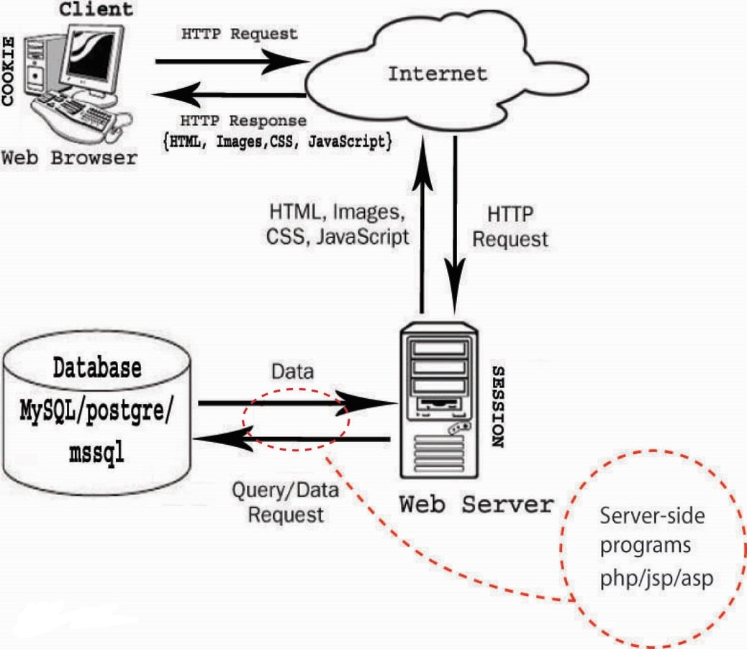
Basics: HTTP Concept

Slide 27
End of 2.1
Will start with 2.2 NOW ☺

